Slide 1
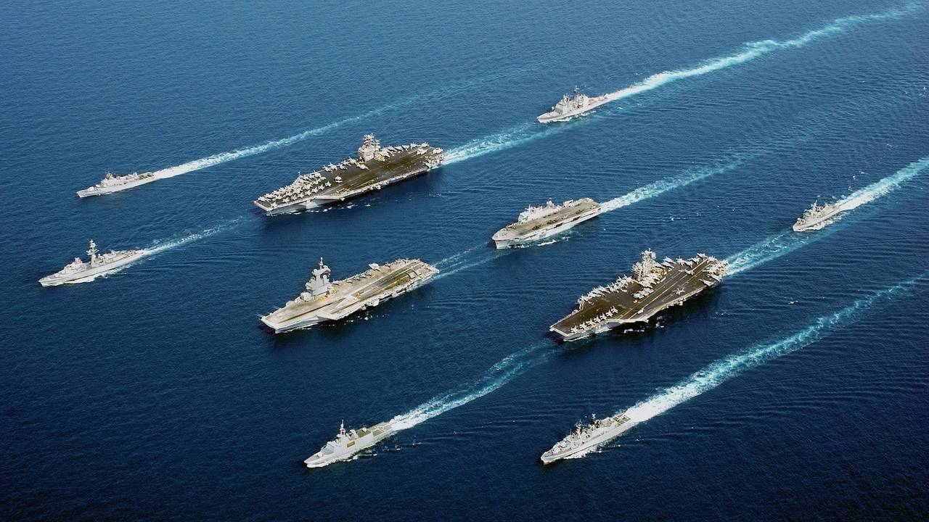
CAPABILITY BRIEF
Neil McDonnell
President
555.555.1212 | neil@govconchamber.com
CAGE: 1GCC2 | EUI: WASDUNSNOW1

Slide 2
Core Capabilities
Business & Technology Consultancy
Founded in 2010 | HQ in Washington, DC
$5M CY21 Revenue with 15+ Public & Private Clients
10+ Active Task Orders
STARS III Prime Contract Holder
Specializing in the Federal Market
Government contracting is not a secret, it’s just a process. We teach small businesses that process
Cloud
Doing lots of cloud stuff for you
Migrations and such
Cyber
Your Red Team
Your Blue Team
AI/ML
Artificial Intelligence
Machine Learning
Experienced Leaders and Staff
30+ Full-Time Employees (>35% Veterans)
60% have DoD Clearance Levels
>90% Retention Rate
>80% have Professional Certifications
Led by USAF Retired Officers
In-House Contracts and Accounting Team

Slide 3
Proven Relationships
Federal Customer Sampling
State/Local/Commercial Customers
DoD
Navy
USMC
USTRANSCOM
NGA
DISA
SDDC
DHS
Trusted Federal Teaming Partners

Slide 4
Cloud Service Line

Slide 5
Cyber Service Line

Slide 6
AI/ML Service Line

Slide 7
Naval Sea Systems Command Case Study
Security Operations
Situation
Paragraph 1
Paragraph 2
Approach
Paragraph 1
Paragraph 2
Outcome / Value Delivered
Paragraph 1
Paragraph 2
Paragraph 3

Slide 8
CAPABILITY BRIEF
Neil McDonnell
President
555.555.1212 | neil@govconchamber.com
CAGE: 1GCC2 | EUI: WASDUNSNOW1

